Slide 1
SoK: Data Sovereignty
Jens Ernstberger^{1,8}, Jan Lauinger¹, Fatima Elsheimy², Liyi Zhou^{3,8},
Sebastian Steinhorst¹, Ran Canetti⁴, Andrew Miller^{5,7}, Arthur Gervais³, Dawn Song^{6,8}
¹Technical University of Munich
²Yale University
³Imperial College London
⁴Boston University
⁵University of Illinois at Urbana-Champaign
⁶University of California, Berkeley
⁷IC3, ⁸Berkeley Center for Responsible Decentralized Intelligence

Slide 2
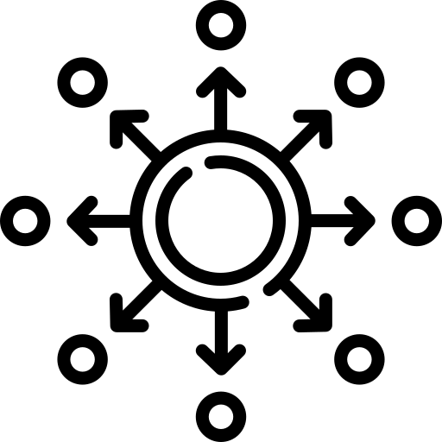
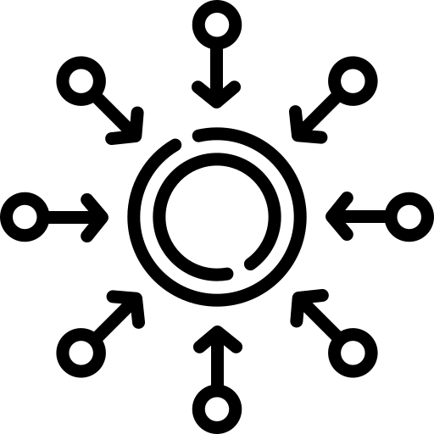
What is Data Sovereignty?
The Web today
Your Data is controlled by corporations
The Web tomorrow
Your key controls your data!
Notes:
Control without intermediary entity

Slide 3
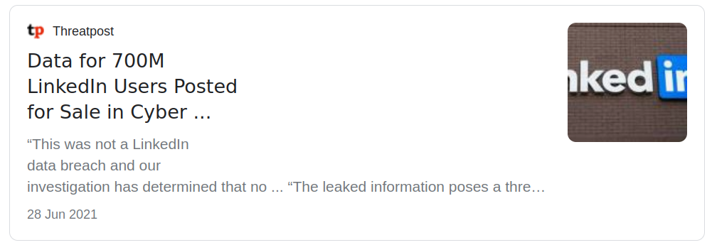
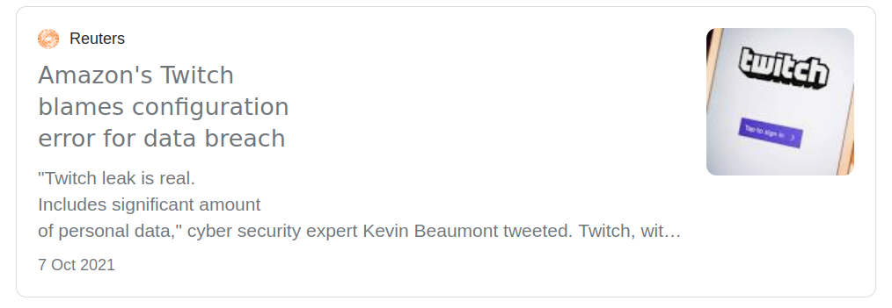
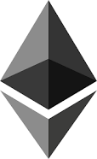
Why care about Data Sovereignty?
Centralization of user data is labor-intensive, costly and intransparent!
Existing applications show feasibility of digital sovereignty!
https://www.reuters.com/technology/amazons-twitch-hit-by-data-breach-2021-10-06/
https://www.reuters.com/technology/amazons-twitch-hit-by-data-breach-2021-10-06/
?
Notes:
Exciting Applications already in existence - control over key makes DeFi applications possible
Many future applications still to be explored Enables many applictions - already today! Potential for growth beyond DeFi is possible

Slide 4
Why did we conduct this work?
Anonymous Credentials
Blockchain
Decentralized Identity
Decentralized Anonymous Credentials
DID v0.1
CanDiD
CL04
BBS+
ZEBRA
2005
2010
2015
2020
Coconut
zkCreds
What is the current state of identity?
What are research areas & challenges beyond decentralized identity?
Notes:
Beyond Decentralized Identity -> Timeline!

Slide 5
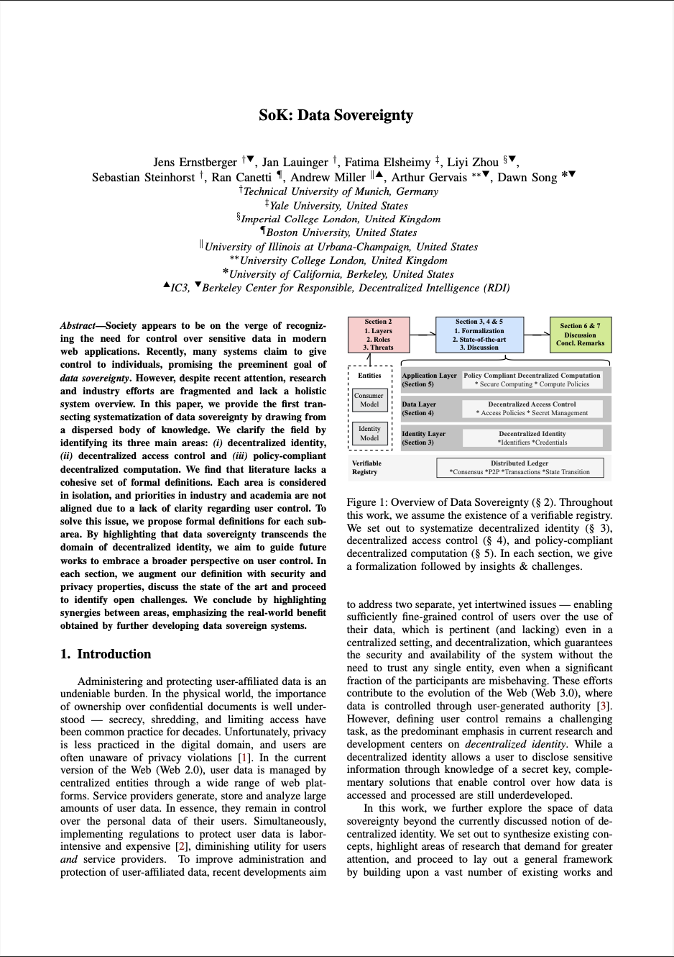
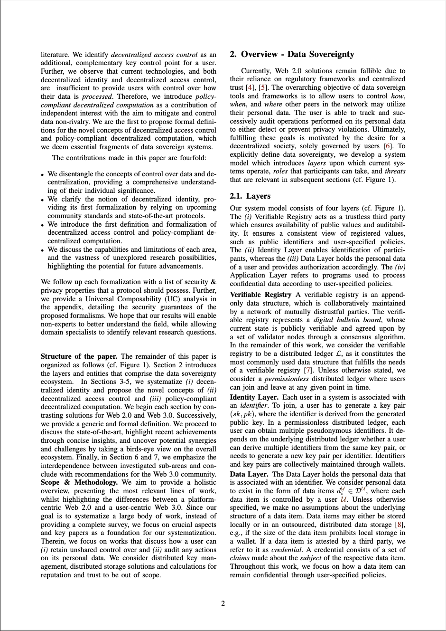
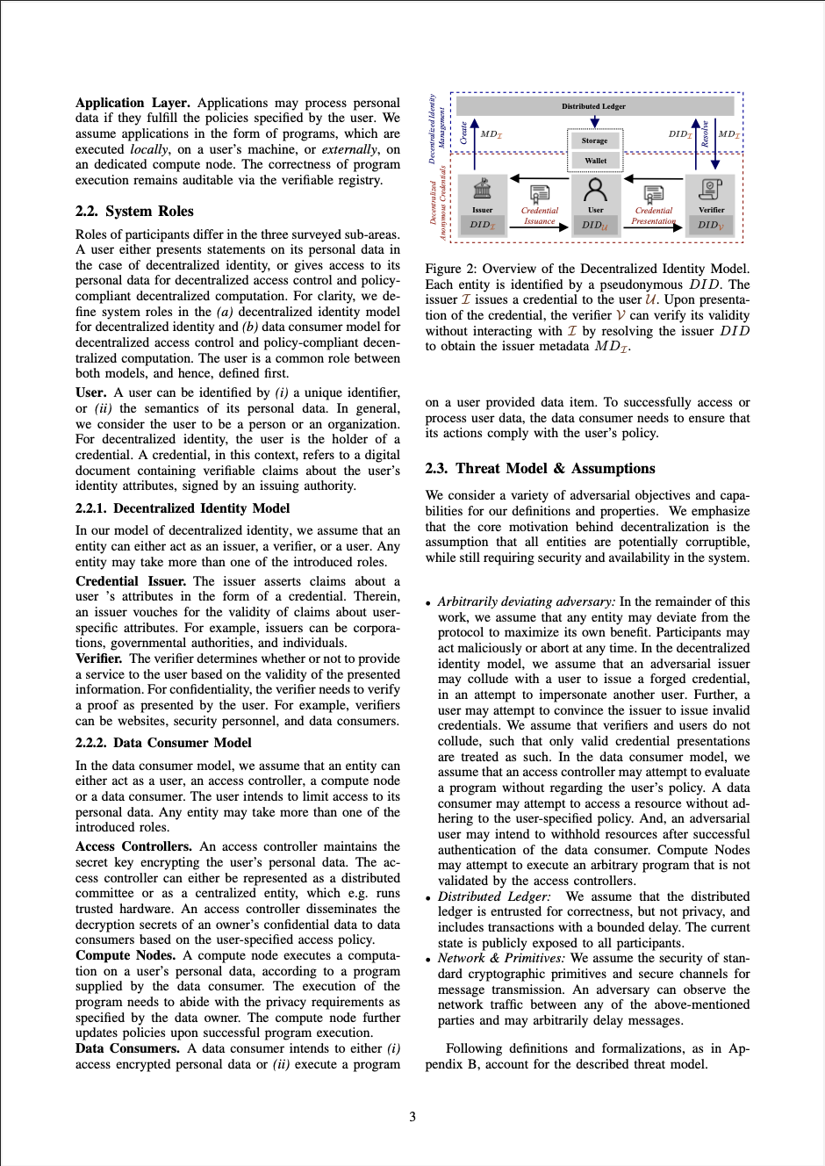
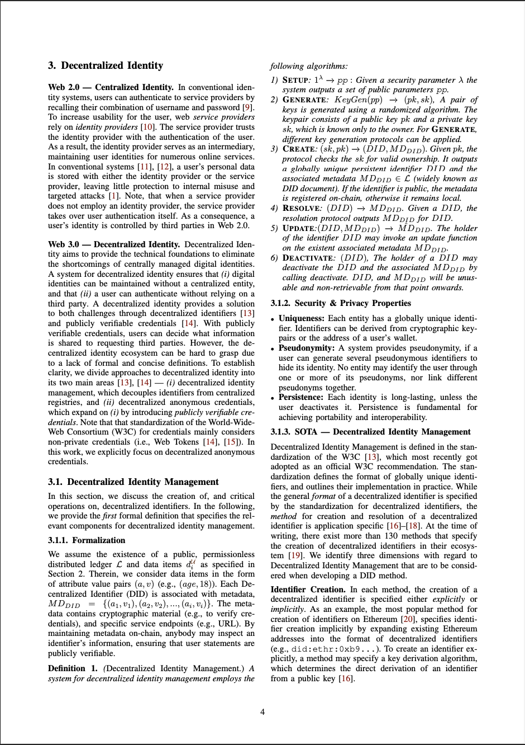
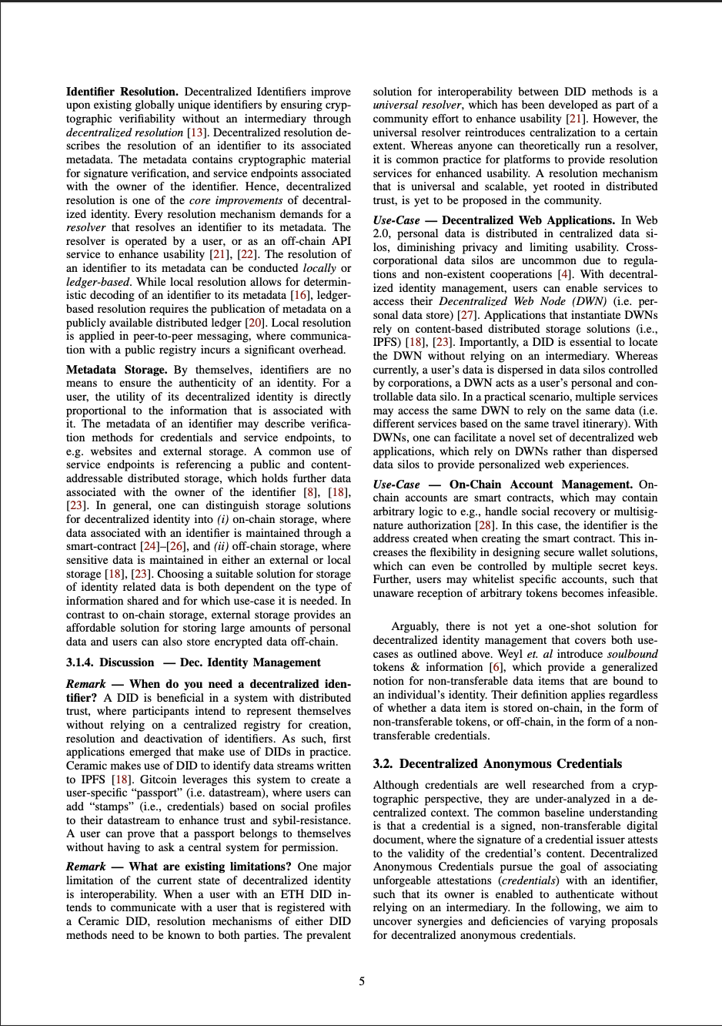
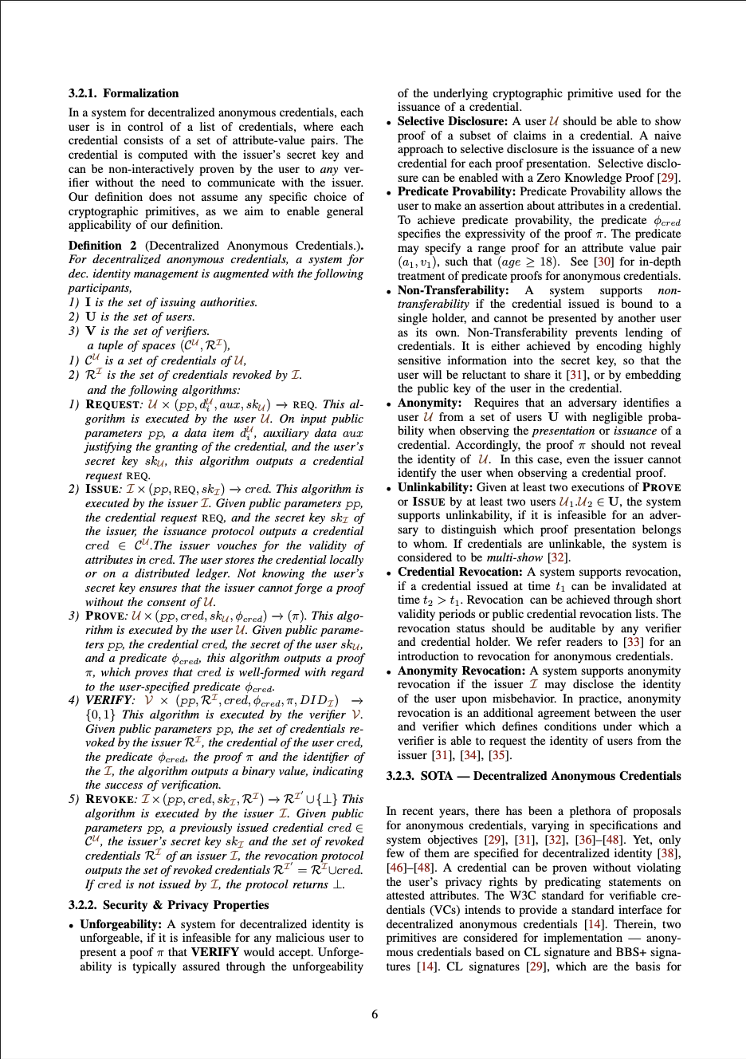
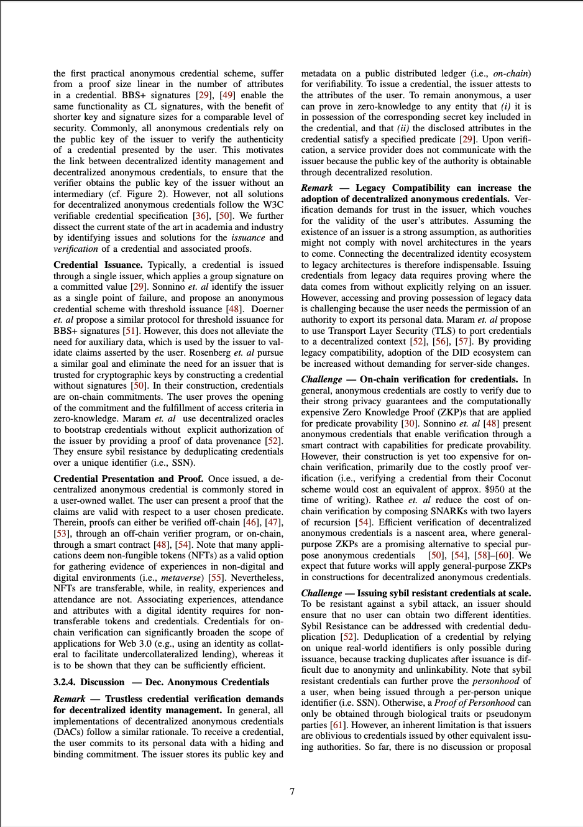
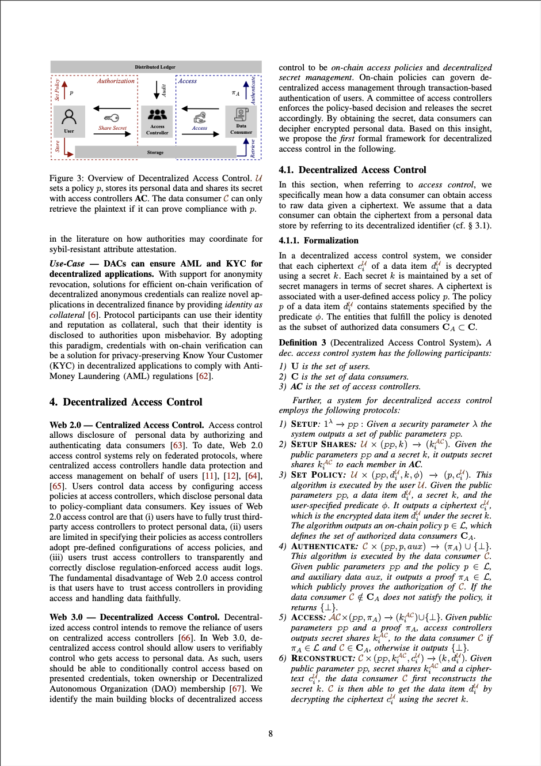
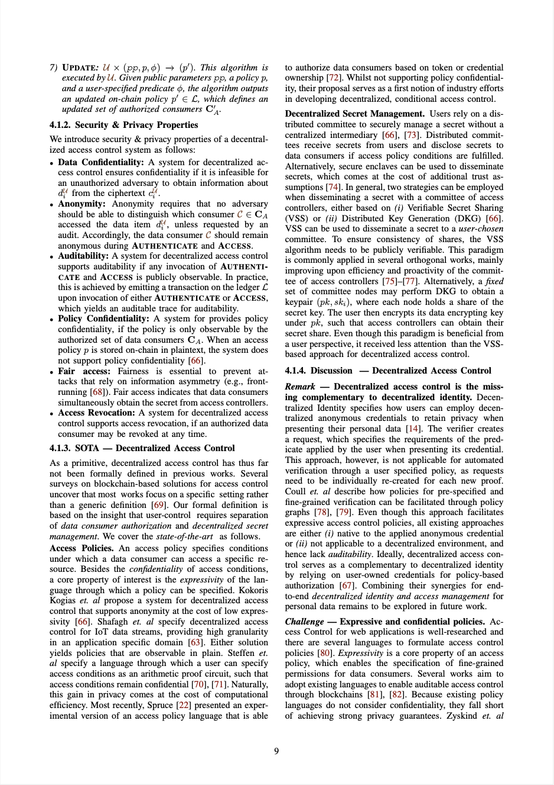
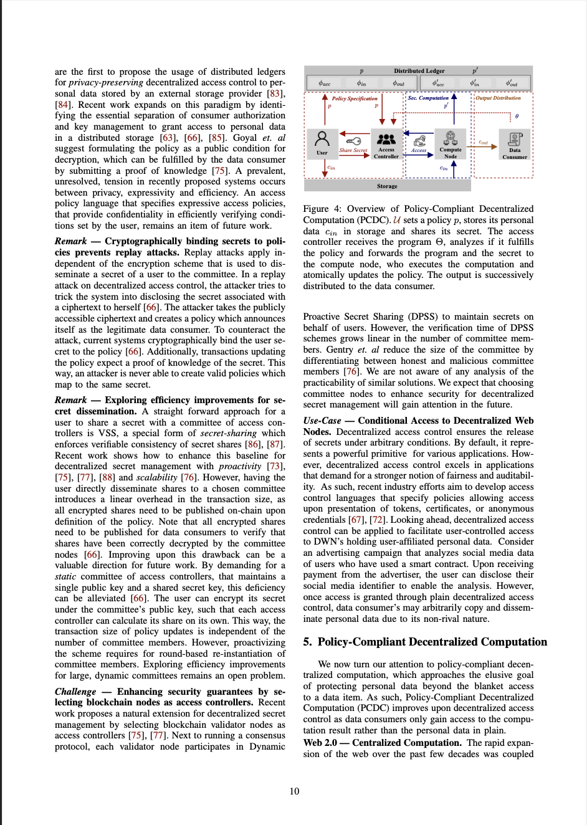
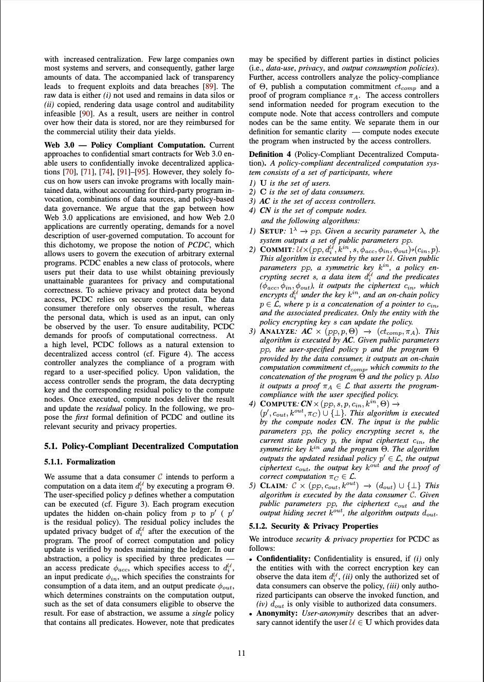
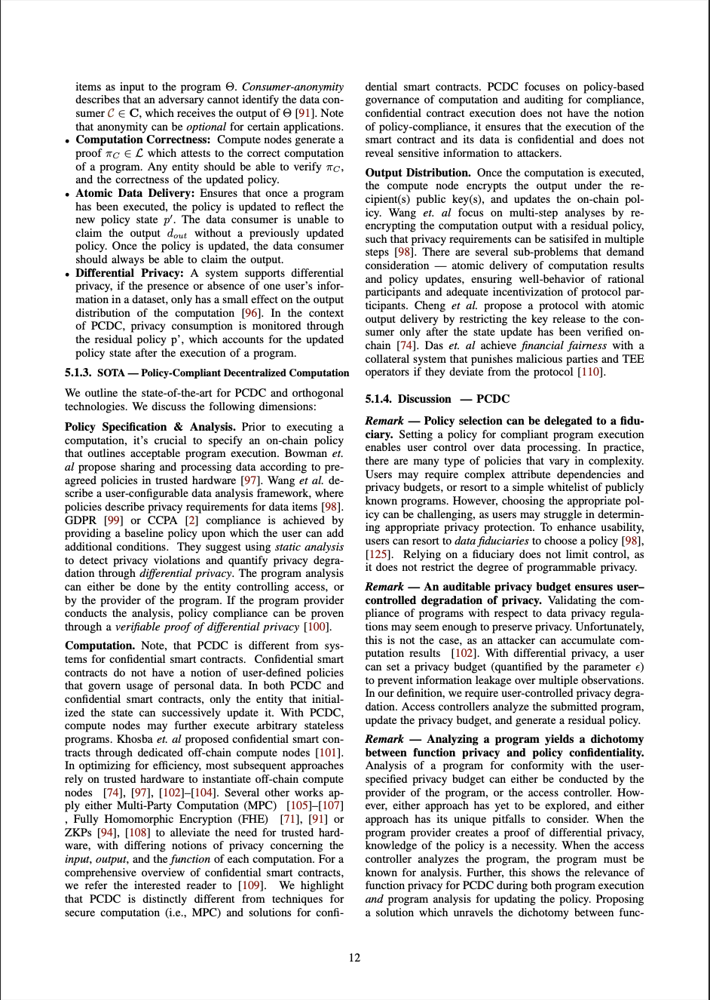
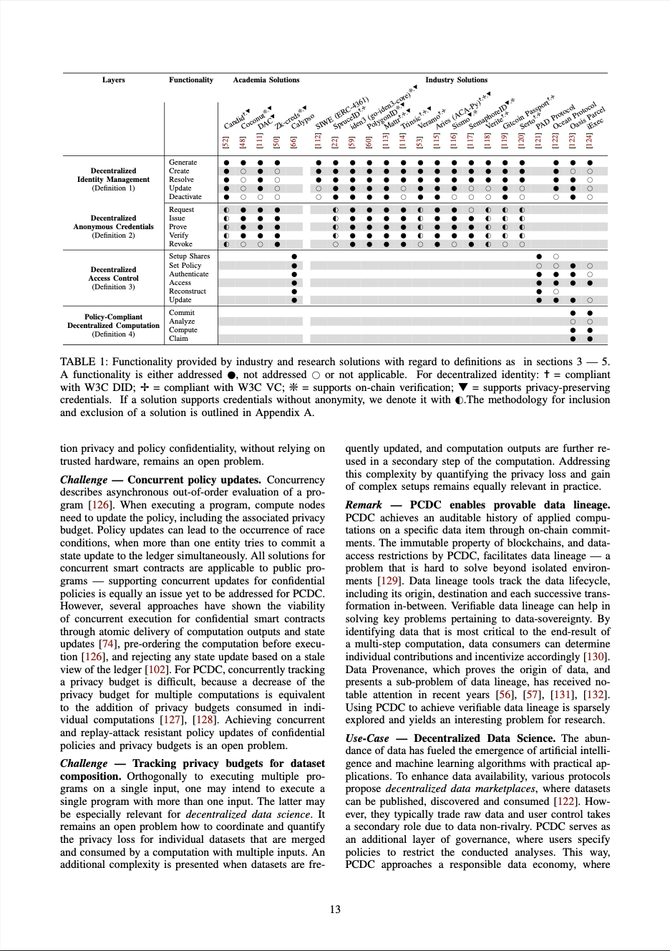
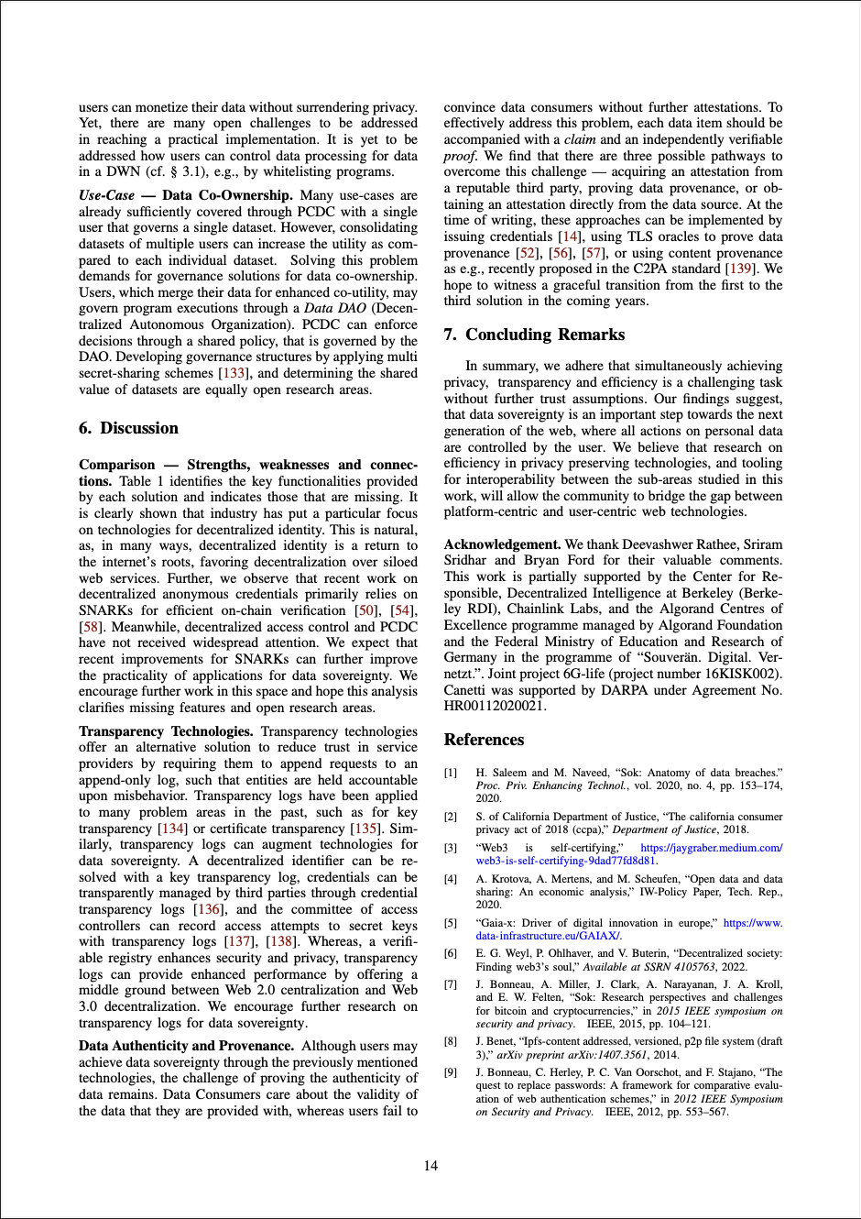
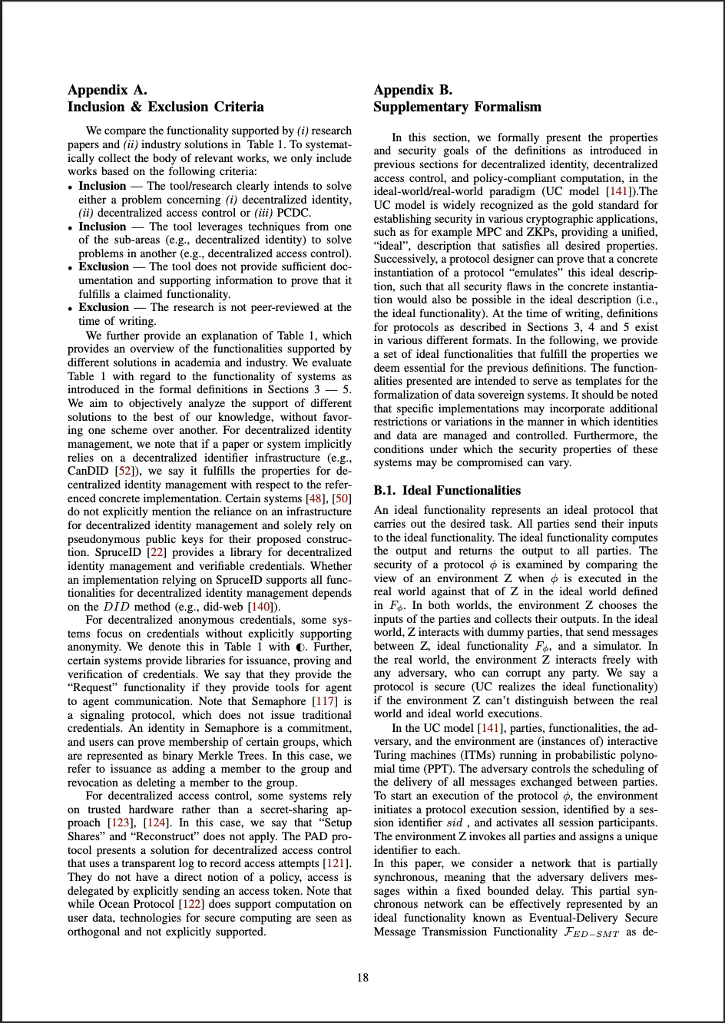
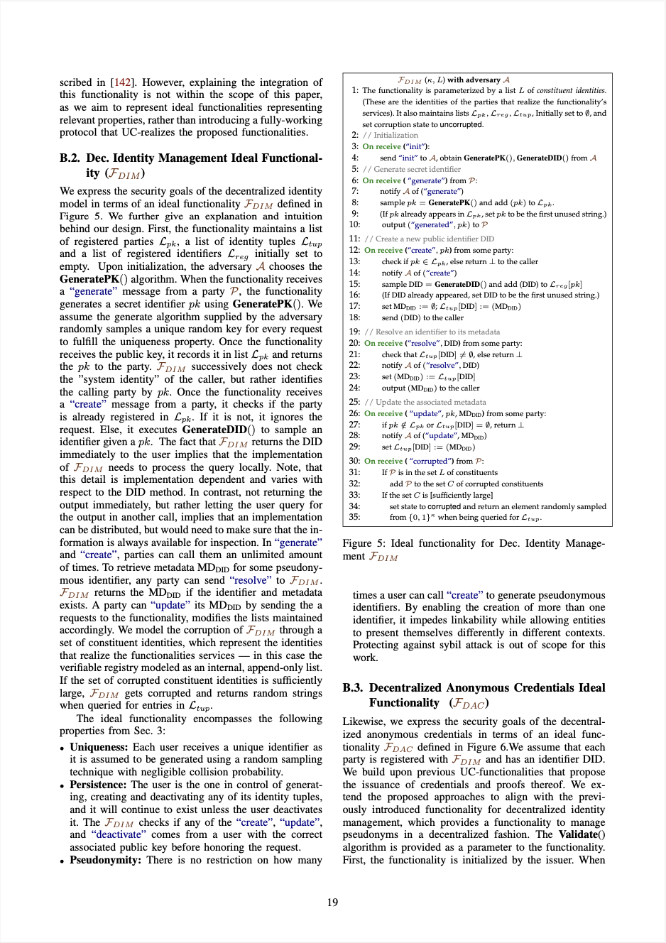
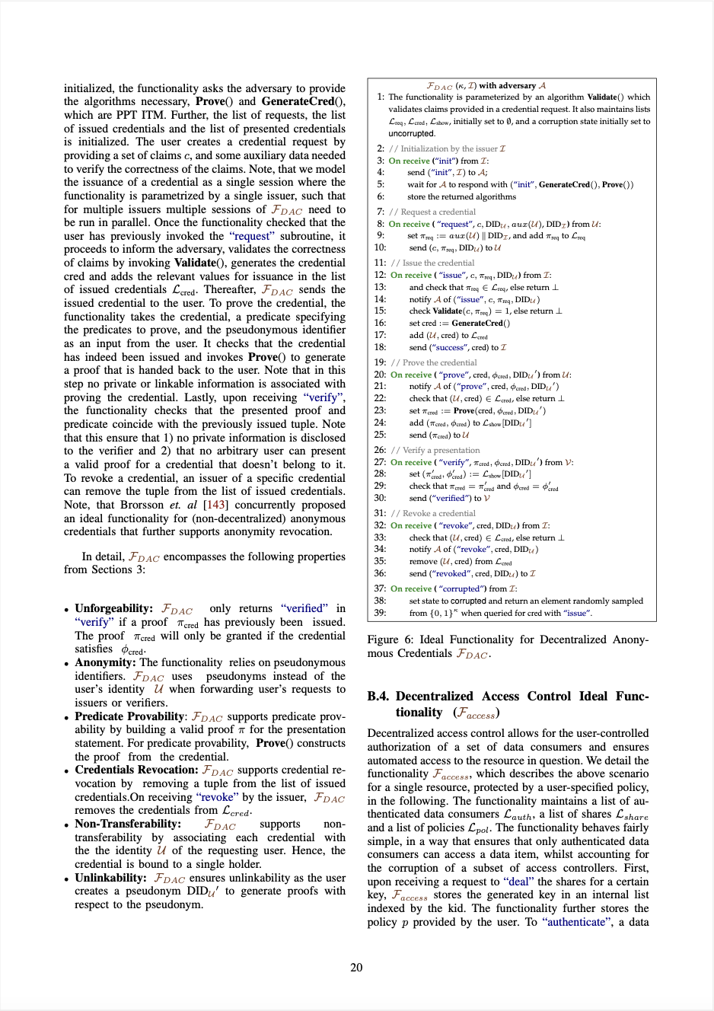
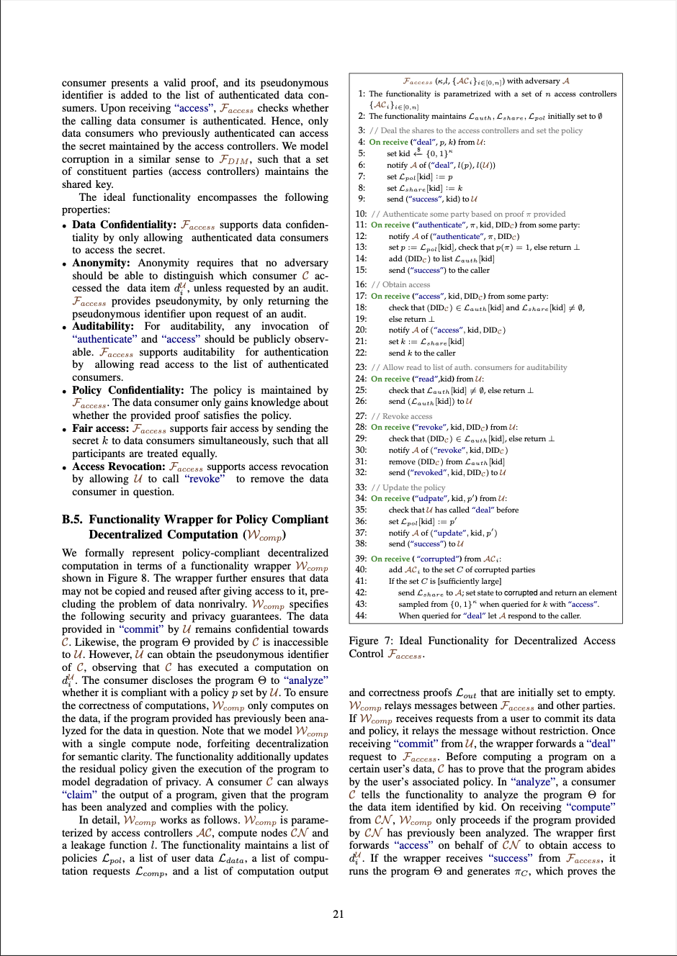
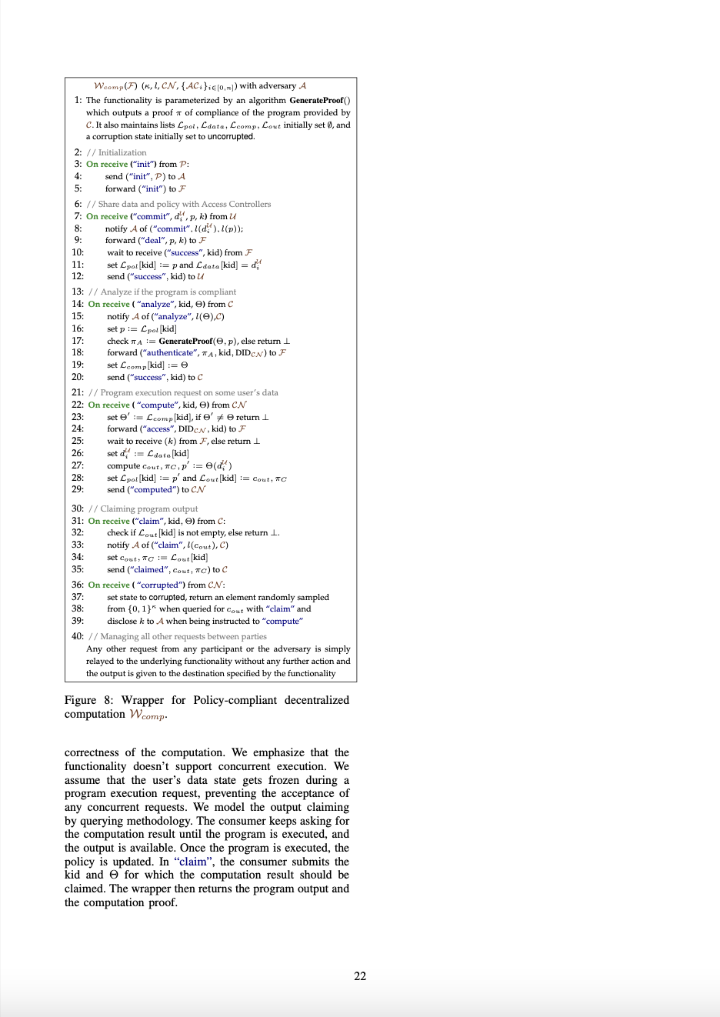
This Work
System & Threat Model
Decentralized Identity
Decentralized Access Control
Policy Compliant Decentralized Computation
Ideal Functionalities in the UC Model
Formalization
SOTA
Research Challenges
Notes:
Identification: 3 areas
Why do we choose these? -> Key Control Points in the digital world!

Slide 6
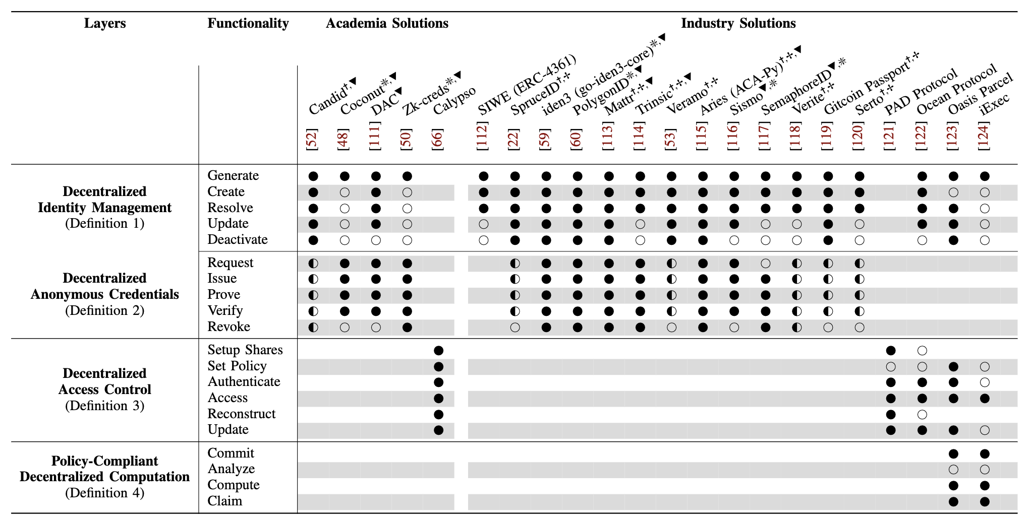
Systematization
Notes:
What are the 3 key points for this slide? - We provide a detailed formalization of APIs with regard to essential security and privacy guarantees
We survey the literature in both academia and industry, providing an overview with regards to which work provides essential functionalities
Results:
Techniques are scattered throughout academia and industry
We formalize API’s and essential security and privacy properties by drawing from >20 works in both academia and industry
Decentralized identity: Lots of tooling, mainly for off-chain applications!
Decentralized Access Control: Unexplored Synergies with Decentralized Identity!
Transition to next slide: Based on that - let me introduce one of the research challenges that we highlight!

Slide 7
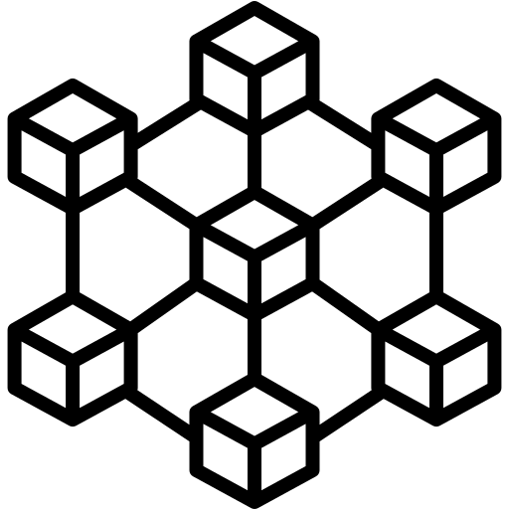
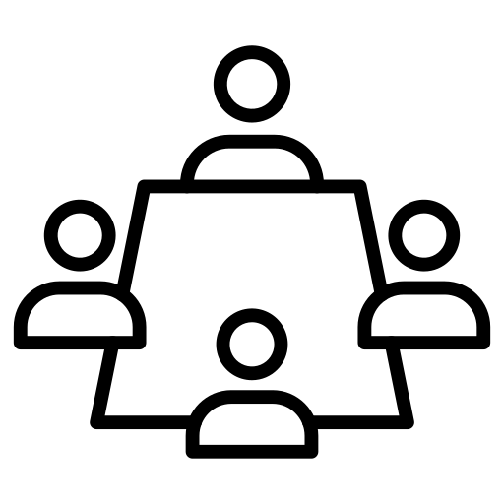
Example Research Challenge
Decentralized Access Control
Web 2.0
Web 3.0
Access is mediated by centralized entities
User-defined policies govern access
centralized
set policy
authenticate
request data
audit
share secret
retrieve secret
Data
retrieve data
Data Owner
Secret Management Committee
Data Consumer
Data Owner
Server
Data Consumer
share Enc(data)
retrieve data
Storage
Notes:
Decentralized Access Control demand sfor separation of authorization and access!

Slide 8
Example Research Challenge
Decentralized Access Control
Data Confidentiality
Anonymity
Auditability
Policy Confidentiality
Fair Access
Access Revocation
Common in Decentralized Identity!
Common in Decentralized Access Control!
Notes:
We discovered that Decentralized Access Control, a companion to Decentralized Identity, is a somewhat untouched terrain. We envision policy-based authorization with user-owned credentials as a potential pathway towards end-to-end decentralized identity and access management.

Slide 9
Conclusion - Takeaways & Future Work
Decentralized Identity → Lots of tooling, mostly for off-chain applications
Decentralized Access Control → Unexplored Synergies with Decentralized Identity
Policy-Compliant Decentralized Computation → Leverage user-control to facilitate a responsible data economy!
Orthogonal Challenges → How to ensure data authenticity and provenance?
→ Data Sovereignty can facilitate a plethora of new use-cases!

Slide 10
Thank You!

